Slide 1
Week 13
Digital Forensics

Slide 2
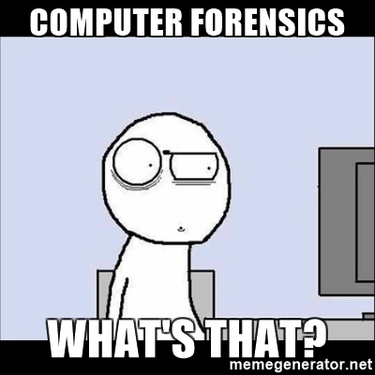
What is Computer Forensics?
Forensics for computers and digital storage media
Goal of examining the evidence in a forensically sound manner
Used in criminal law since mid 1980s

Slide 3
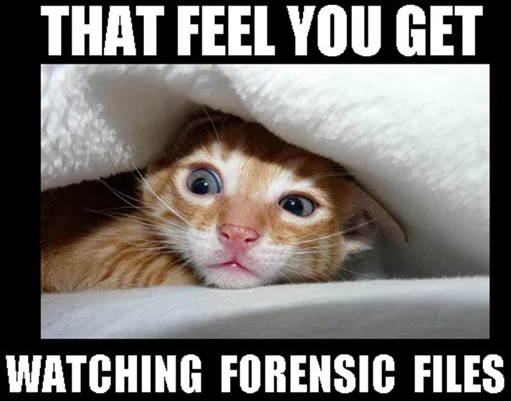
What are the pieces of Computer Forensics
Criminal Investigations
Civil Court Cases
Corporate IT

Slide 4
Careers in Computer Forensics
Police and Law Enforcement
Government Agencies
Audit/Compliance Services
Corporate IT

Slide 5

Digital Evidence types
Disk Drives
Secondary Storage
Cell phones
Other
  Printers
  Game Systems
  Security Alarms
  IoT
Volatile data

Slide 6
Steps of an Investigation
Identify, collect and preserve evidence
Evidence analysis
Reporting and testimony

Slide 7
Duplication and authentication
Forensically correct copy
  Drive image
  Bit stream Image
  ISO image
Write blocked devices and special software/hardware for duplication
Forensically wiped drives
Security hashes and authentication

Slide 8
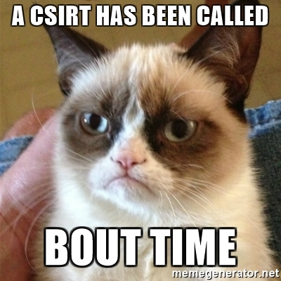
CERT/CSIRT teams
Dealing with an “Incident”
Team members
  Stakeholders
  C-Suite
Prioritize incident
  OMG shut it all down?!?!
  Eh, we can work around it

Slide 9
CERT/CSIRT terms after incident
Identify evidence and preserve it
  Forensic copy
  Logs
  Histories
Analysis
  What happened?
  Why?
  Damage control
  Data loss
Reports! Documentation!

Slide 10

After incident
What can we do to prevent in future?
Changes in structure?
Policy?
Personnel?

Slide 11
Example: A Public Post-Mortem
After its July 2026 breach, Hugging Face published a post-mortem: what happened, when, what was accessed, and what it changed
Post-mortems help the whole industry learn from an incident
  Source: Cloud Security Alliance

